Slide 1
TOP 10 LEADING CAUSES OF DEATH IN USA (1999-2016)
Jose Luis Bracho
Mariana Chavez
Dwight Mauk
Robert Mabry

Slide 2





motivation
To evaluate the leading causes of death in USA and their trend.

Slide 3
Questions and data
What are the top 10 leading causes of death in USA.
Has there been any changes in the past decade?
What is the distribution per State of the most lethal diseases?
How are we doing in Tennessee?
Main data obtained from data.gov
States’ coordinates from inkplant.com/code
Average State temperature from usa.com/rank

Slide 4


Slide 5
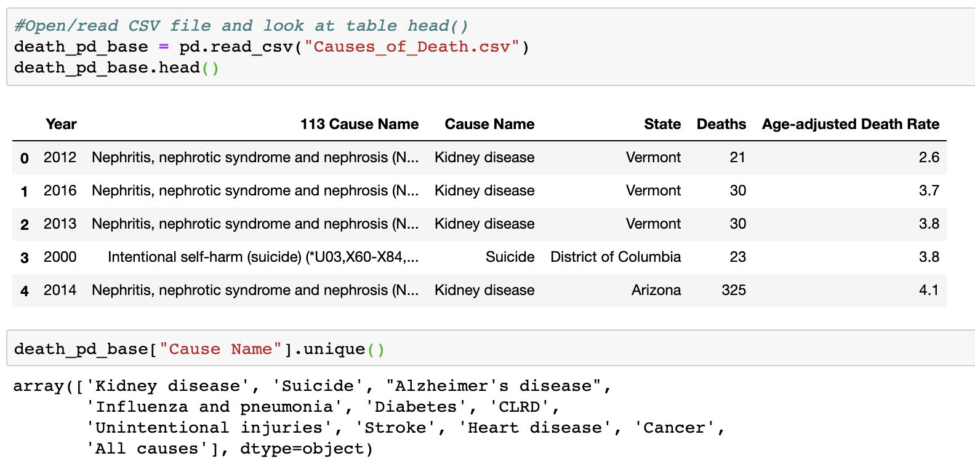

Slide 6
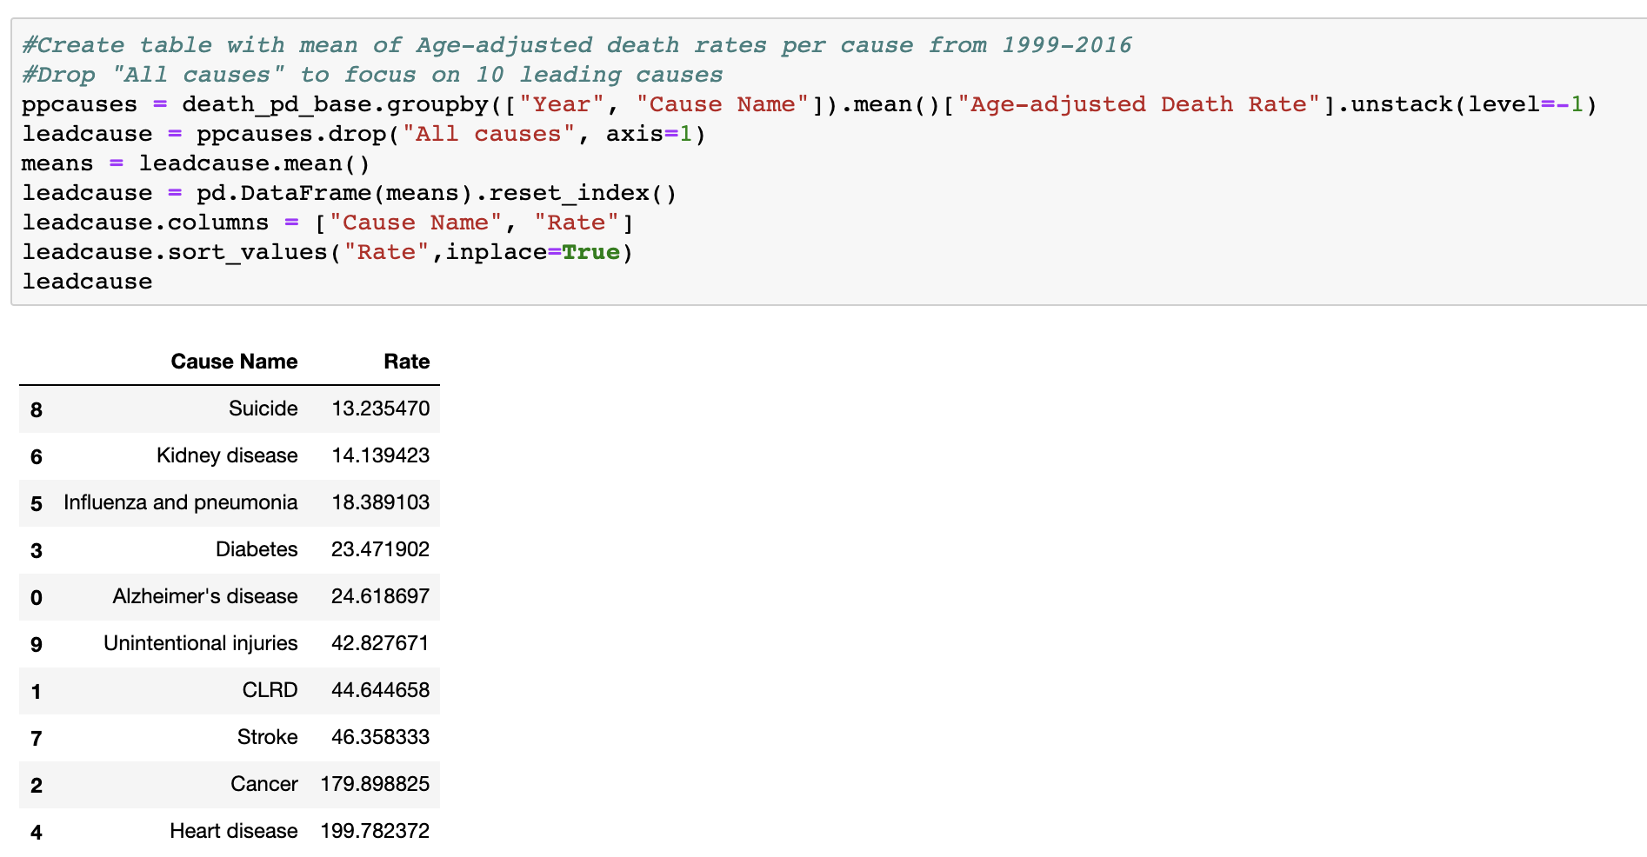

Slide 7
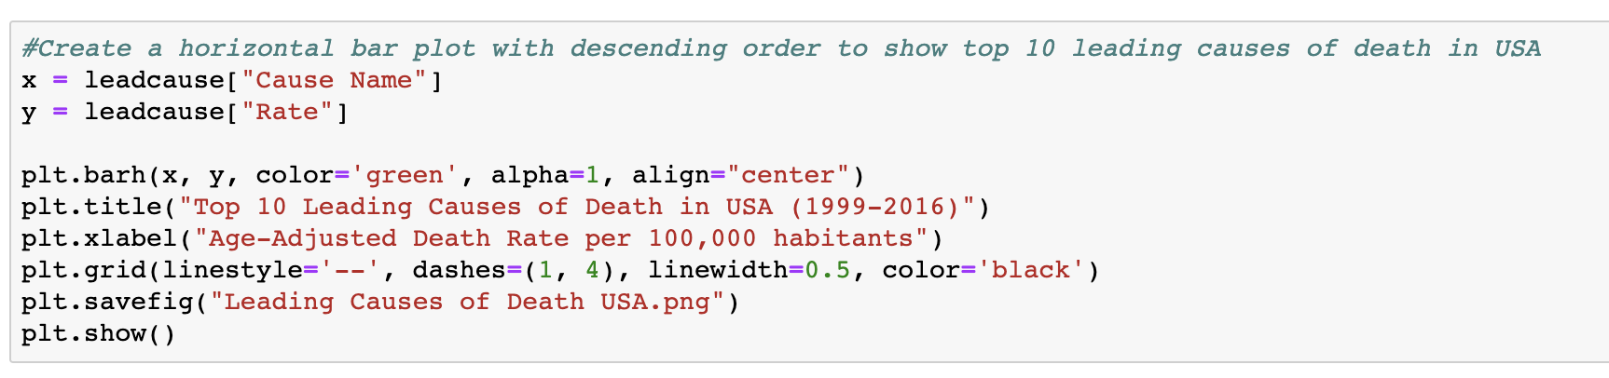
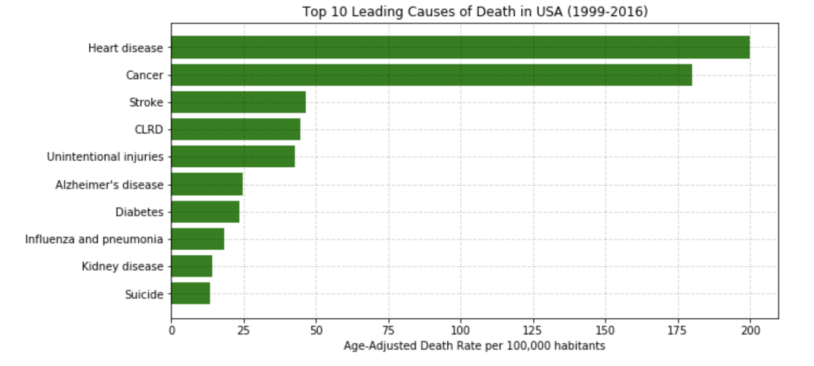

Slide 8
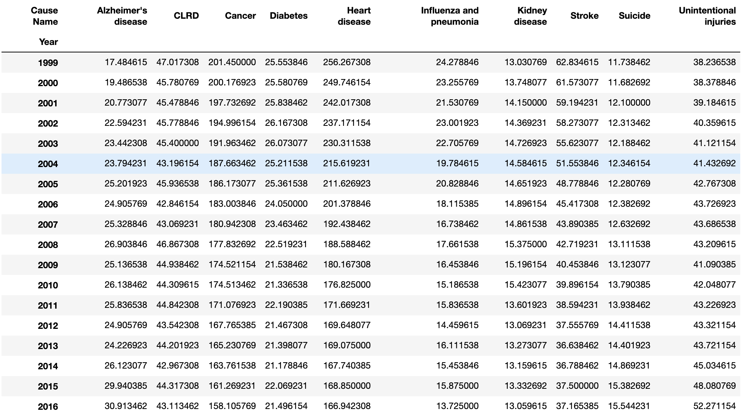

Slide 9
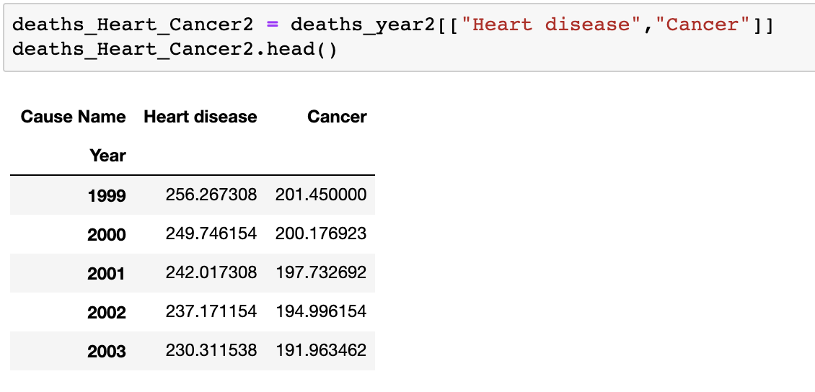
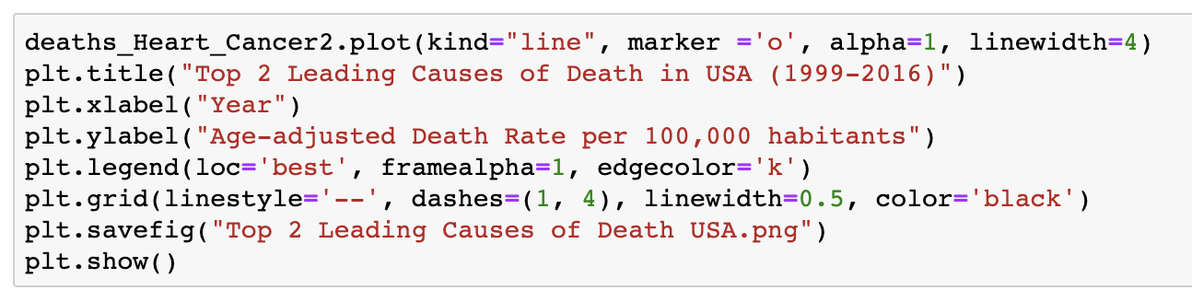

Slide 10
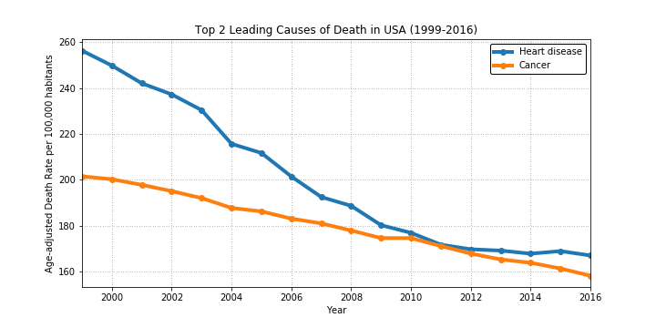

Slide 11
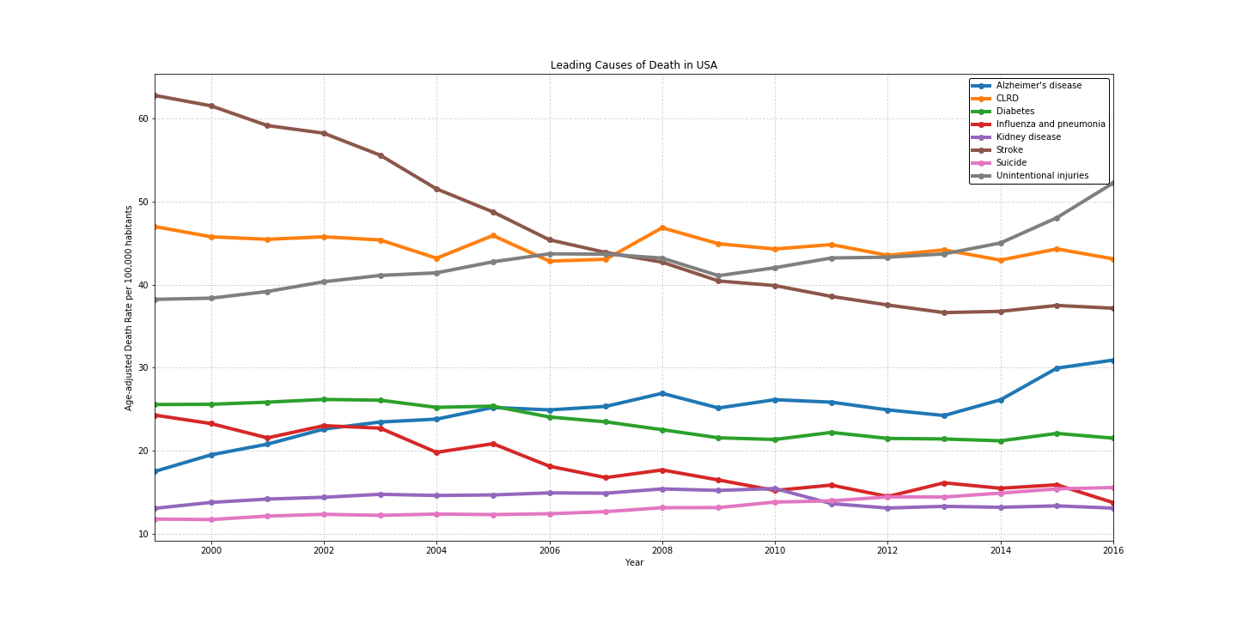

Slide 12
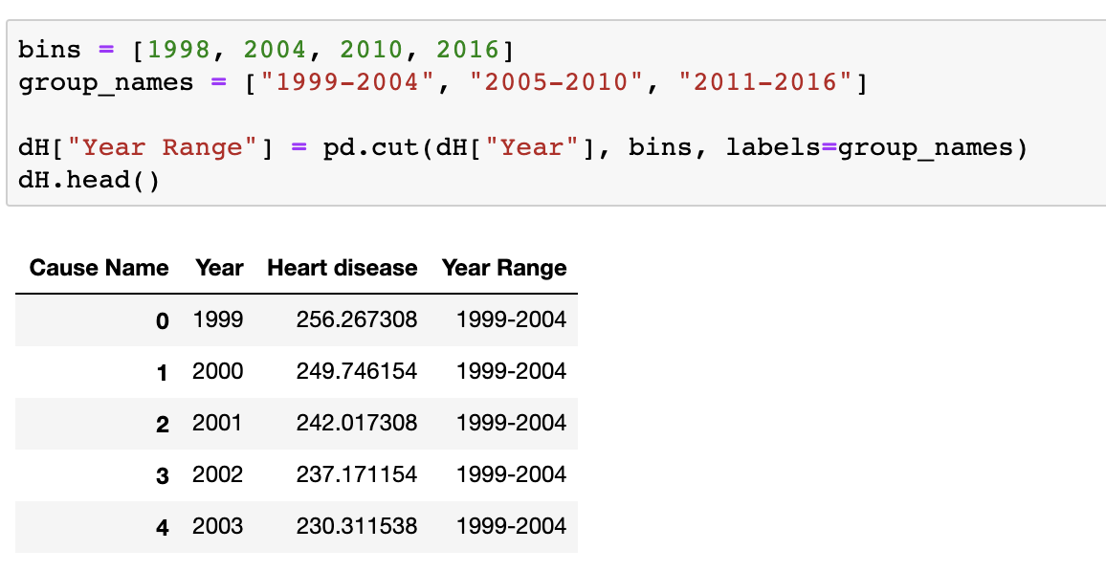
Null Hypothesis #1
- The trend observed on the decrease of death rate for Heart disease and Cancer (meaning, the decrease on age-adjusted death rate per 100,000 habitants) does not represent a significant improvement throughout the years.

Slide 13
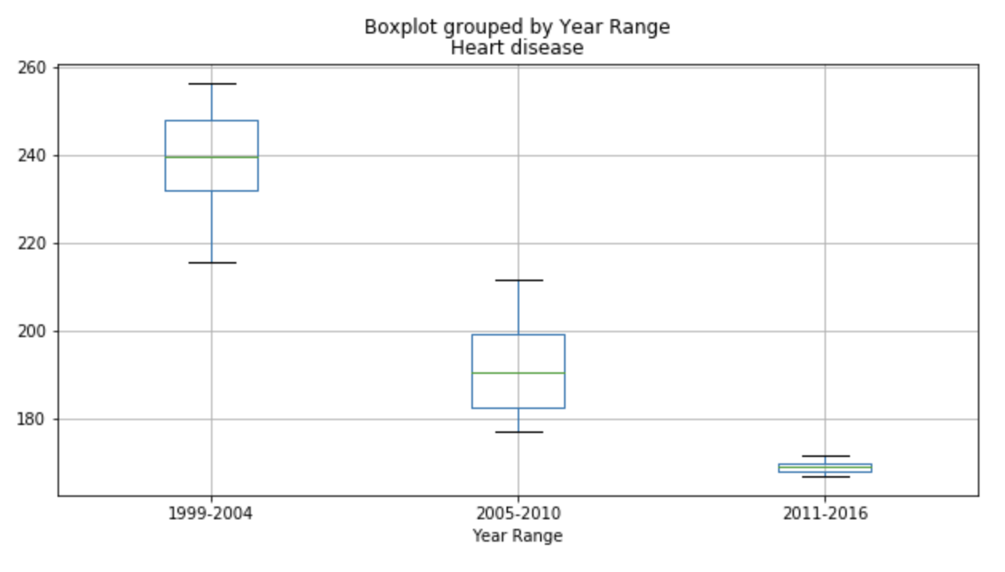

F_onewayResult(statistic=59.02123176539099,pvalue=7.776019794385112e-08)

Slide 14
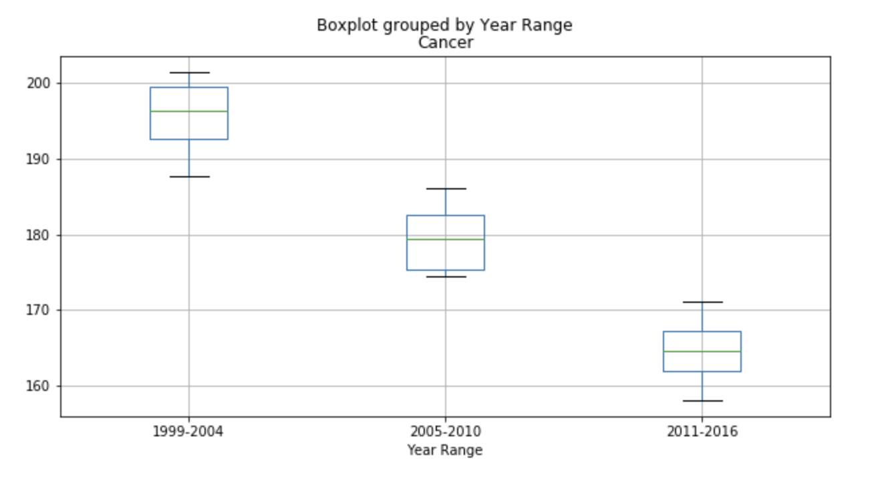

F_onewayResult(statistic=61.63588714863557, pvalue=5.823484514575891e-08)

Slide 15

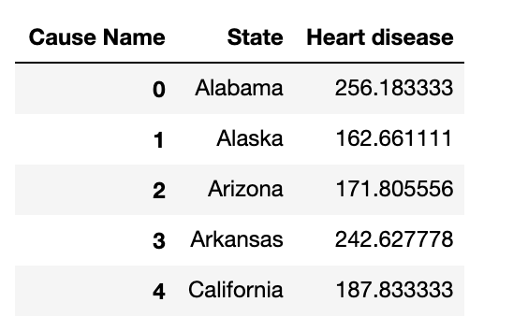

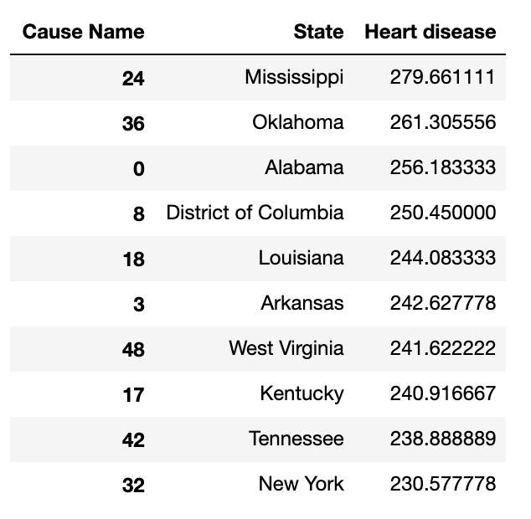

Slide 16

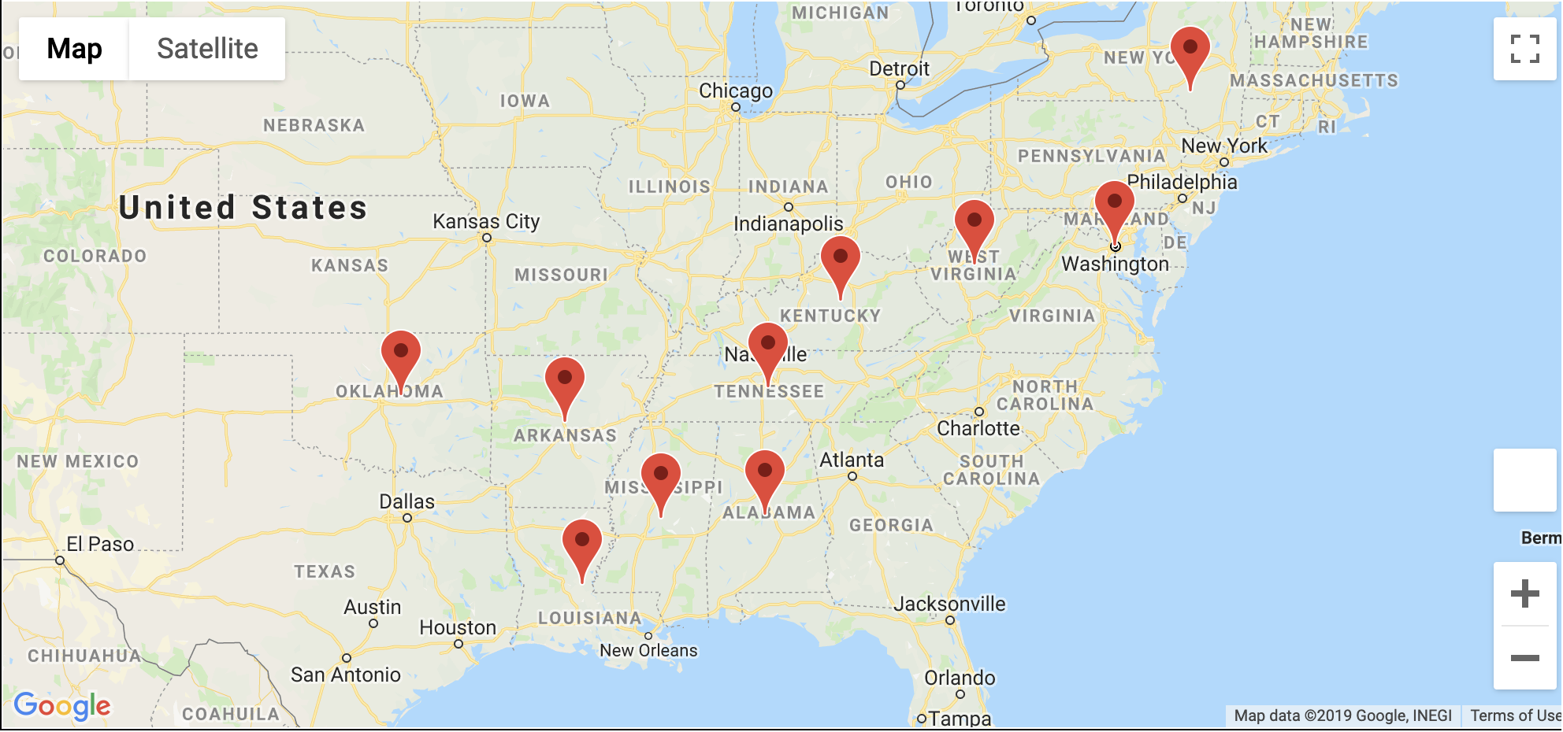

Slide 17

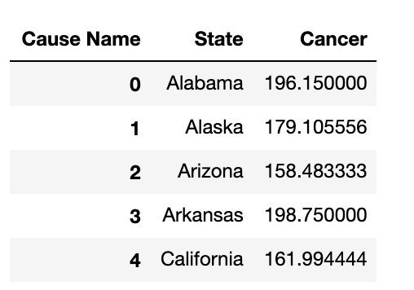
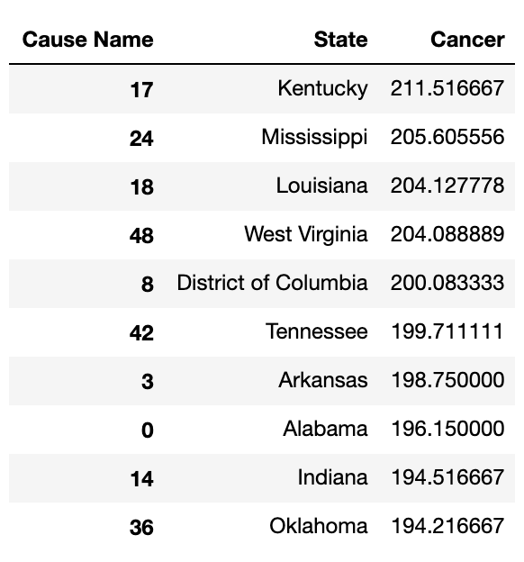


Slide 18

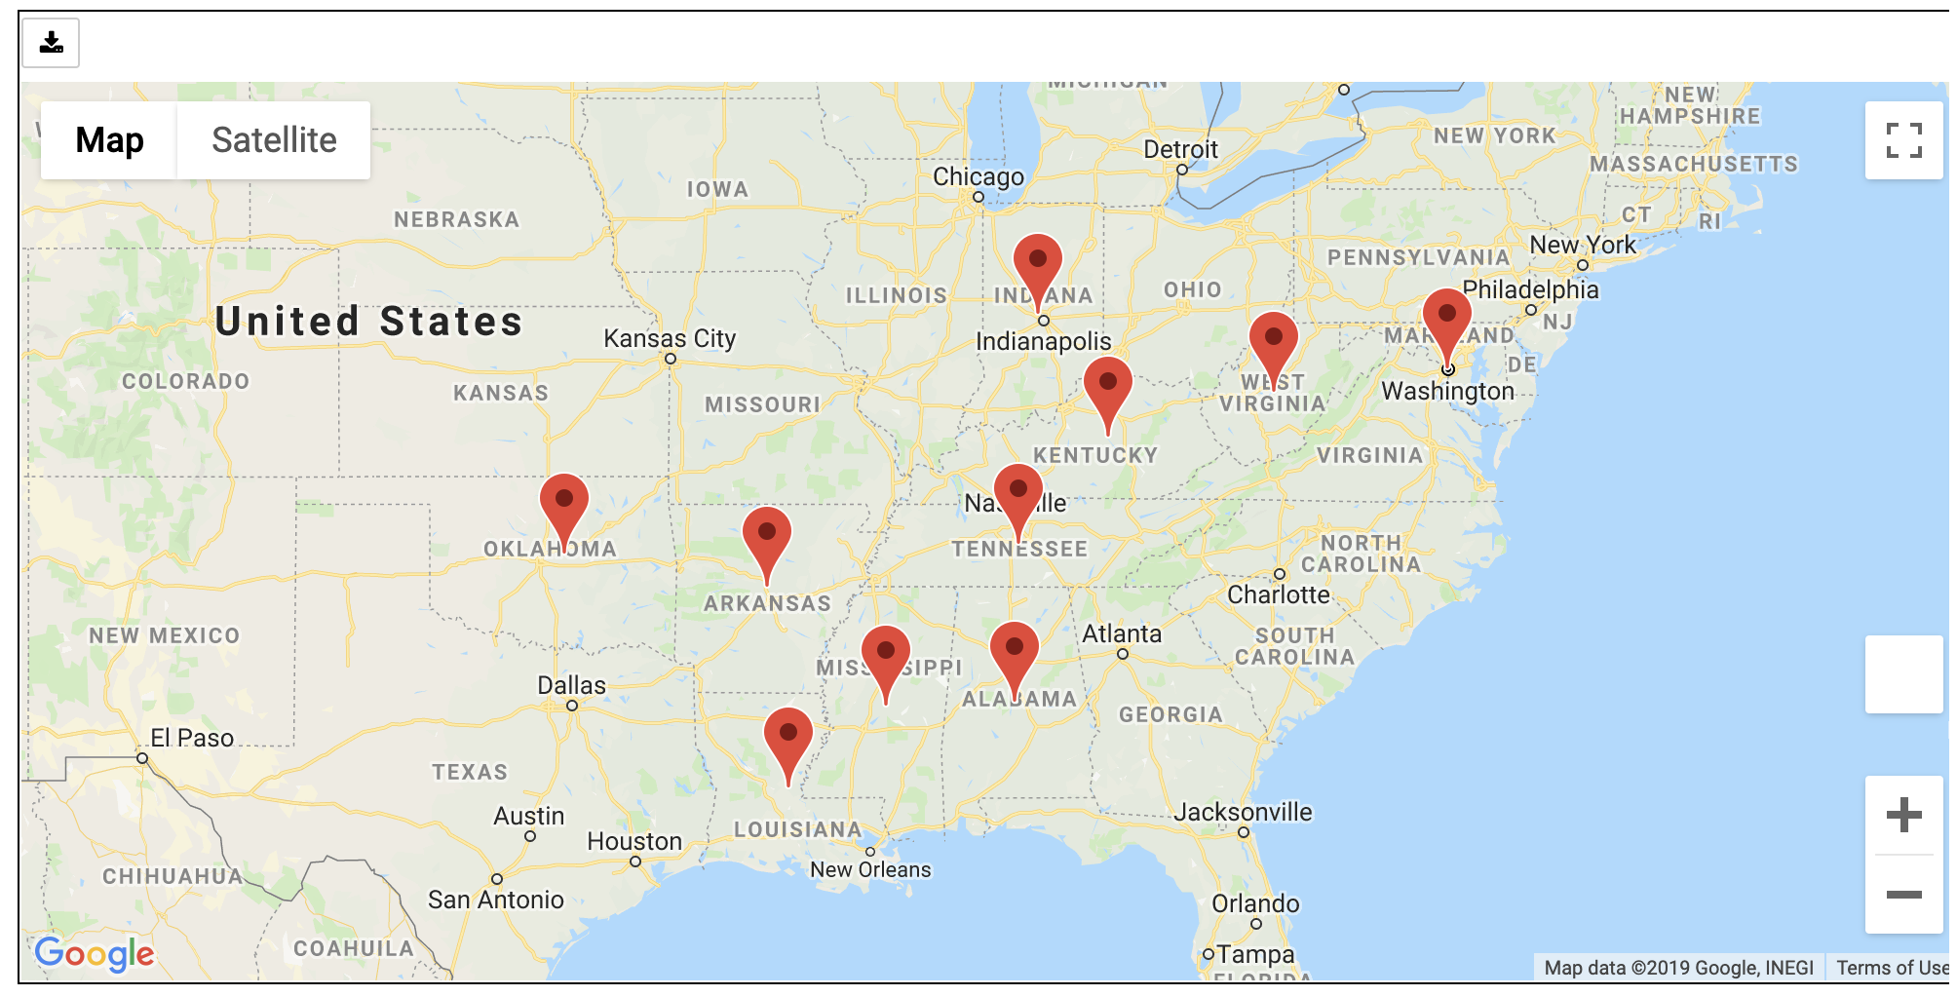

Slide 19

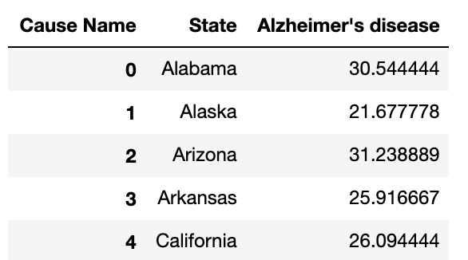

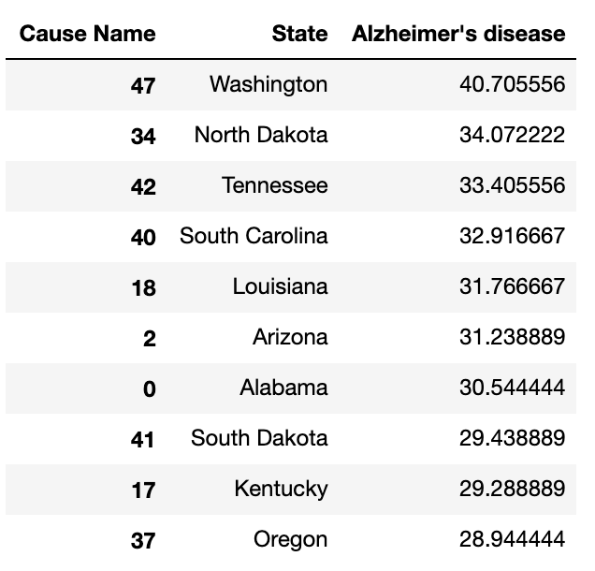

Slide 20
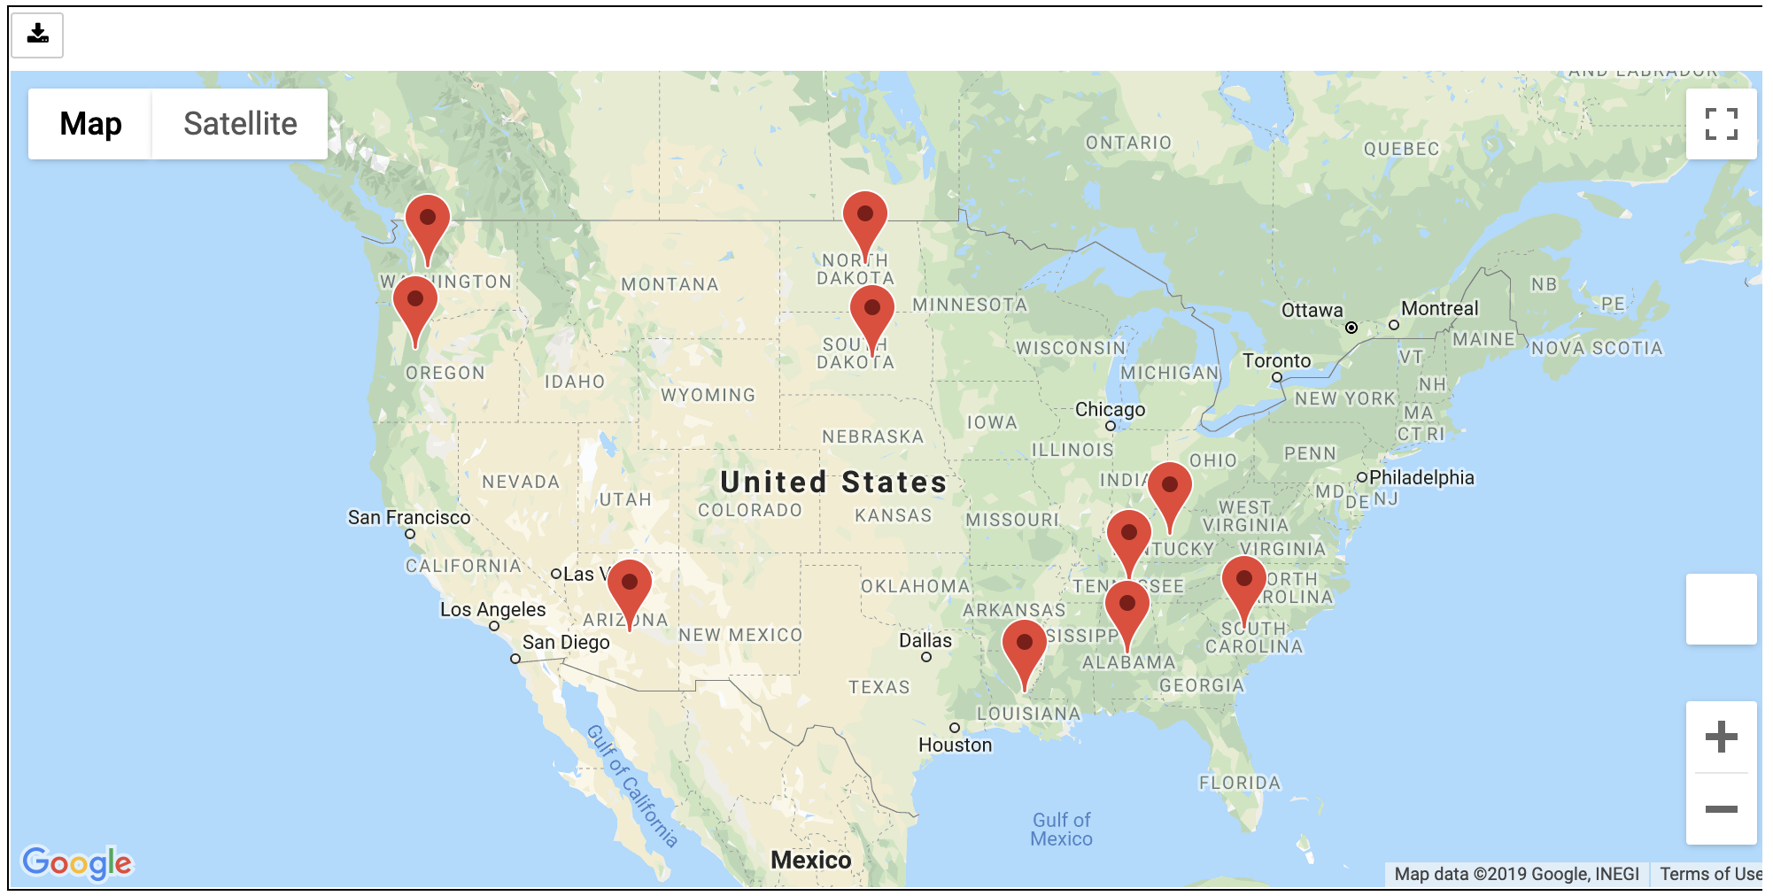

Slide 21
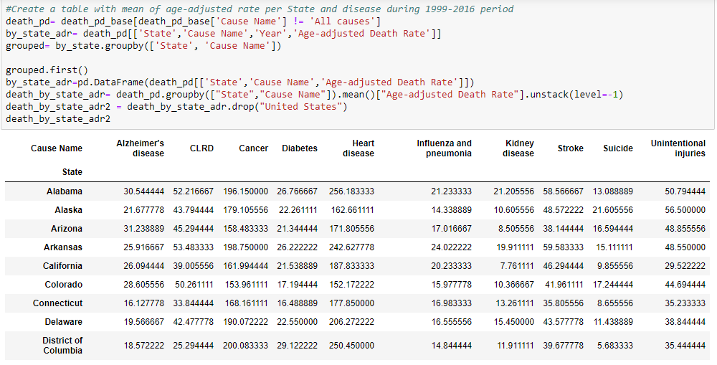

Slide 22
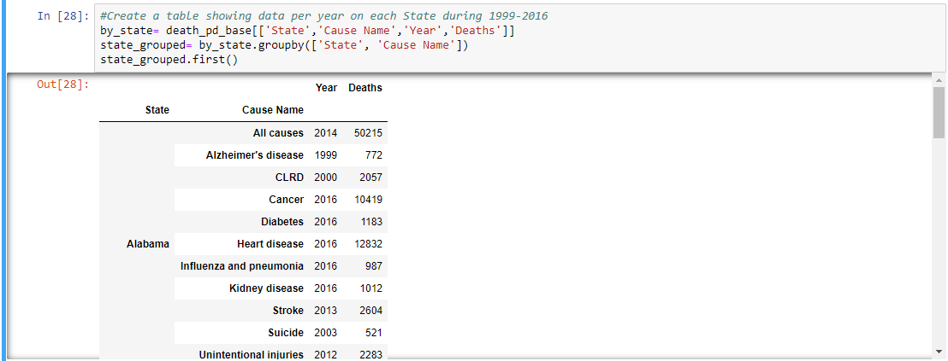

Slide 23
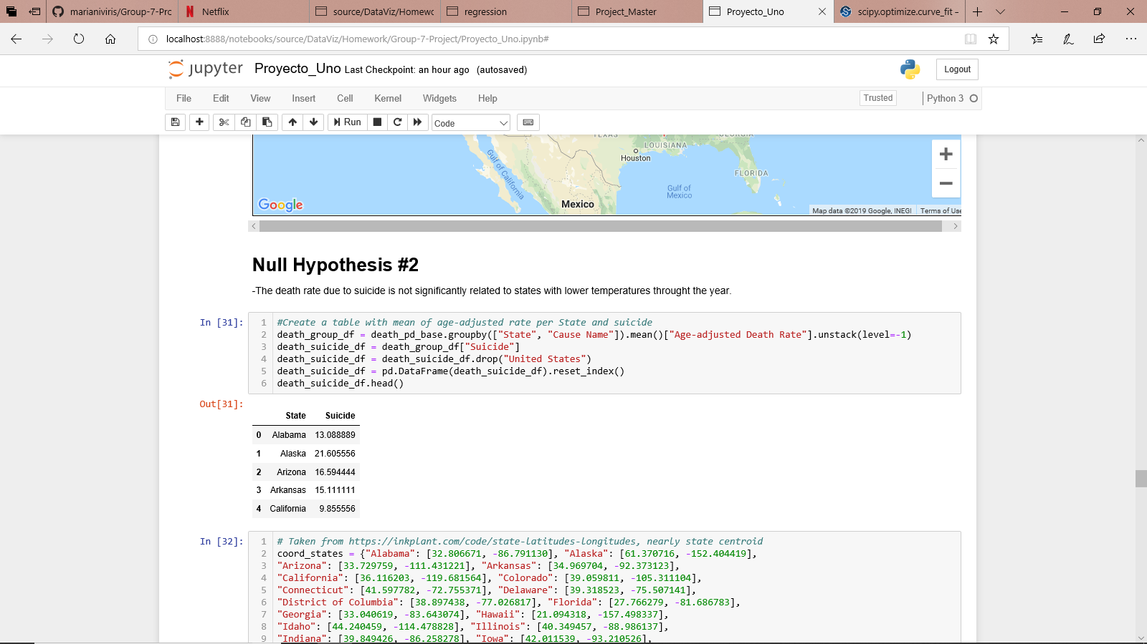
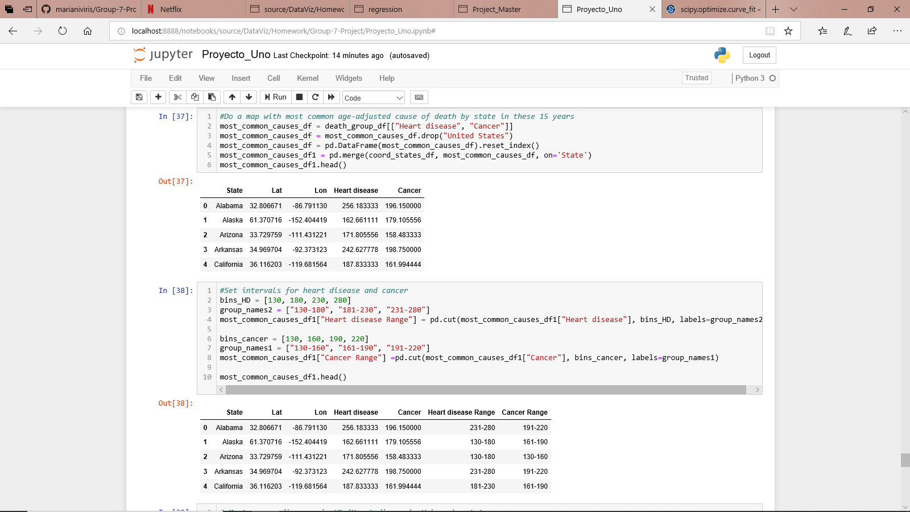

Slide 24
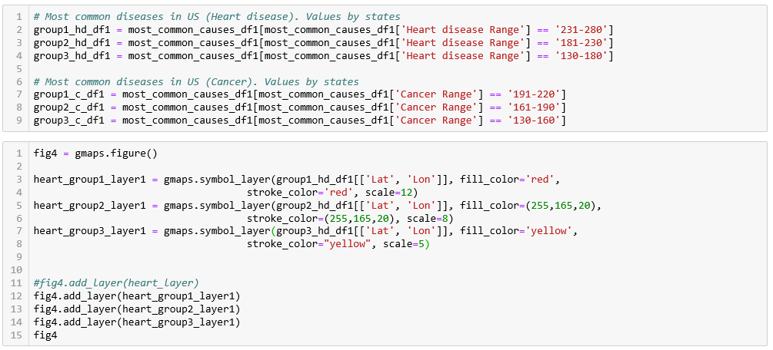

Slide 25
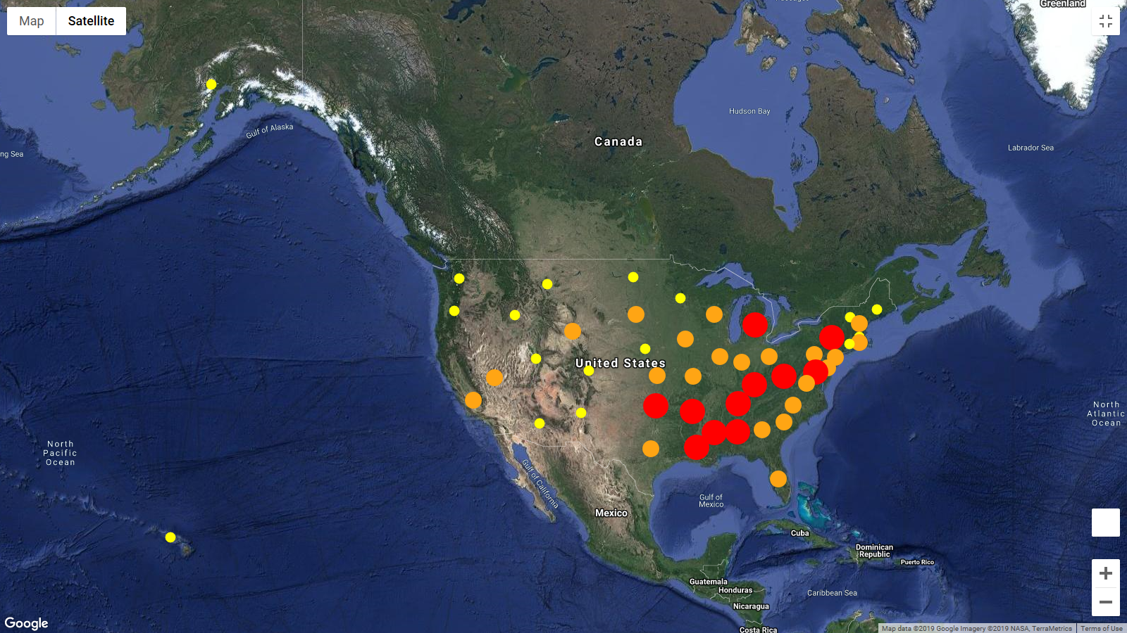

Slide 26
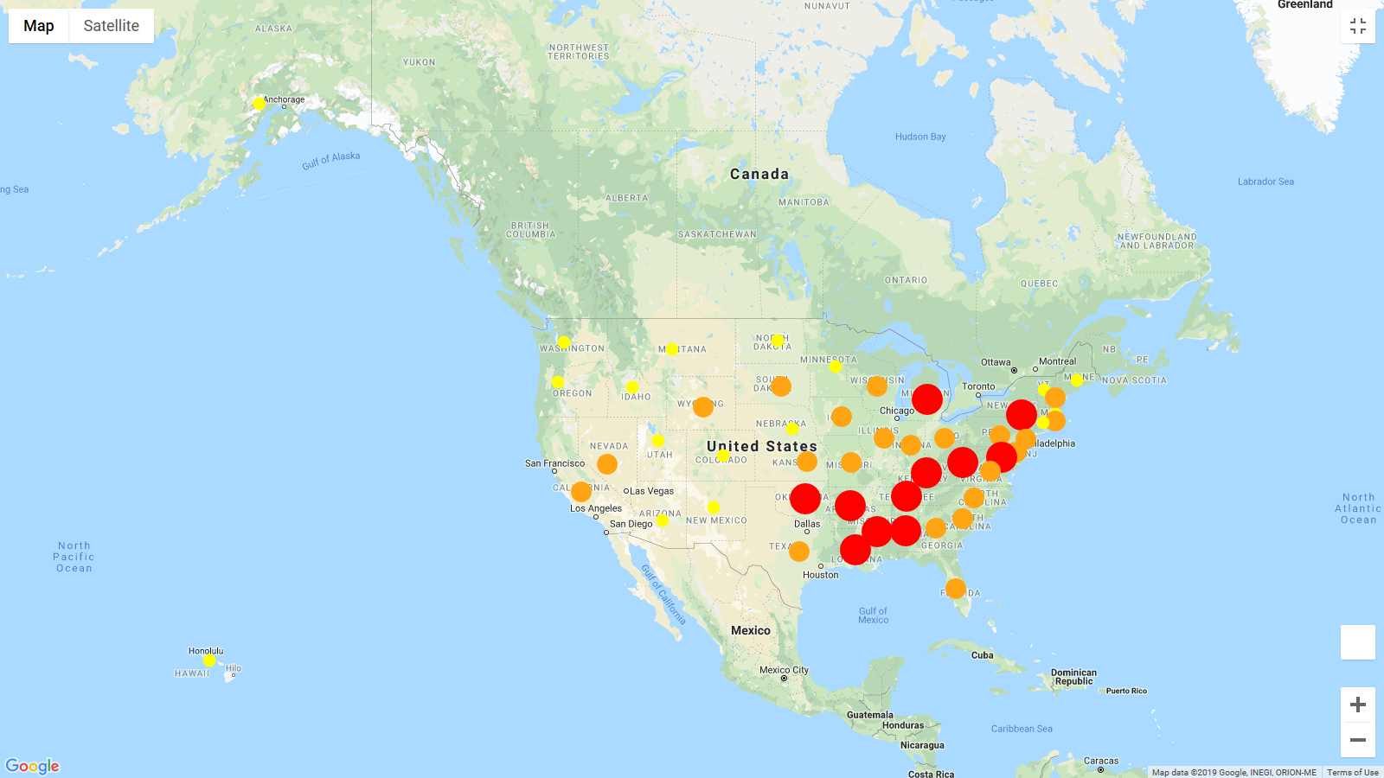
Heart Disease (Age-adjusted Death Rate)
231-280
181-230
130-180

Slide 27
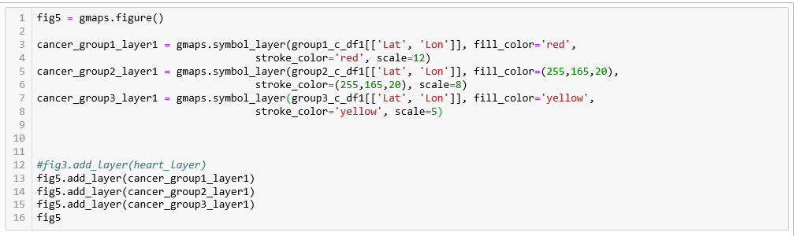

Slide 28
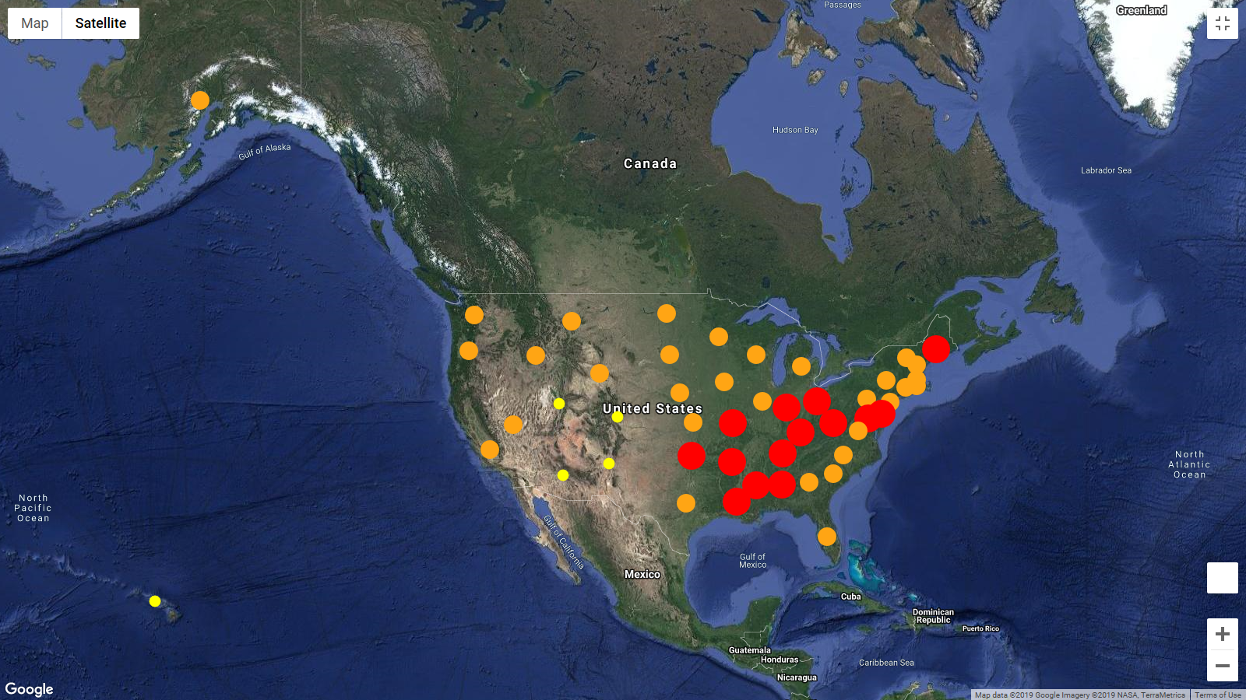

Slide 29
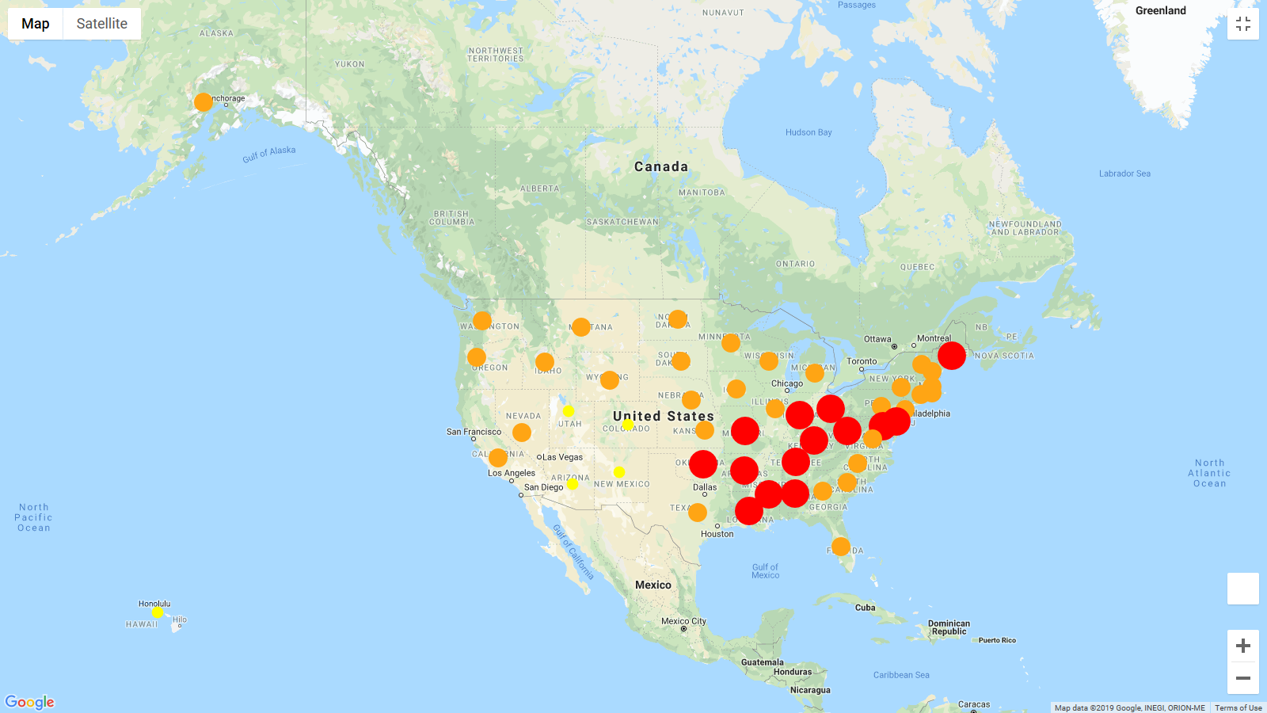
Cancer (Age-adjusted Death Rate)
191-220
161-190
130-160

Slide 30
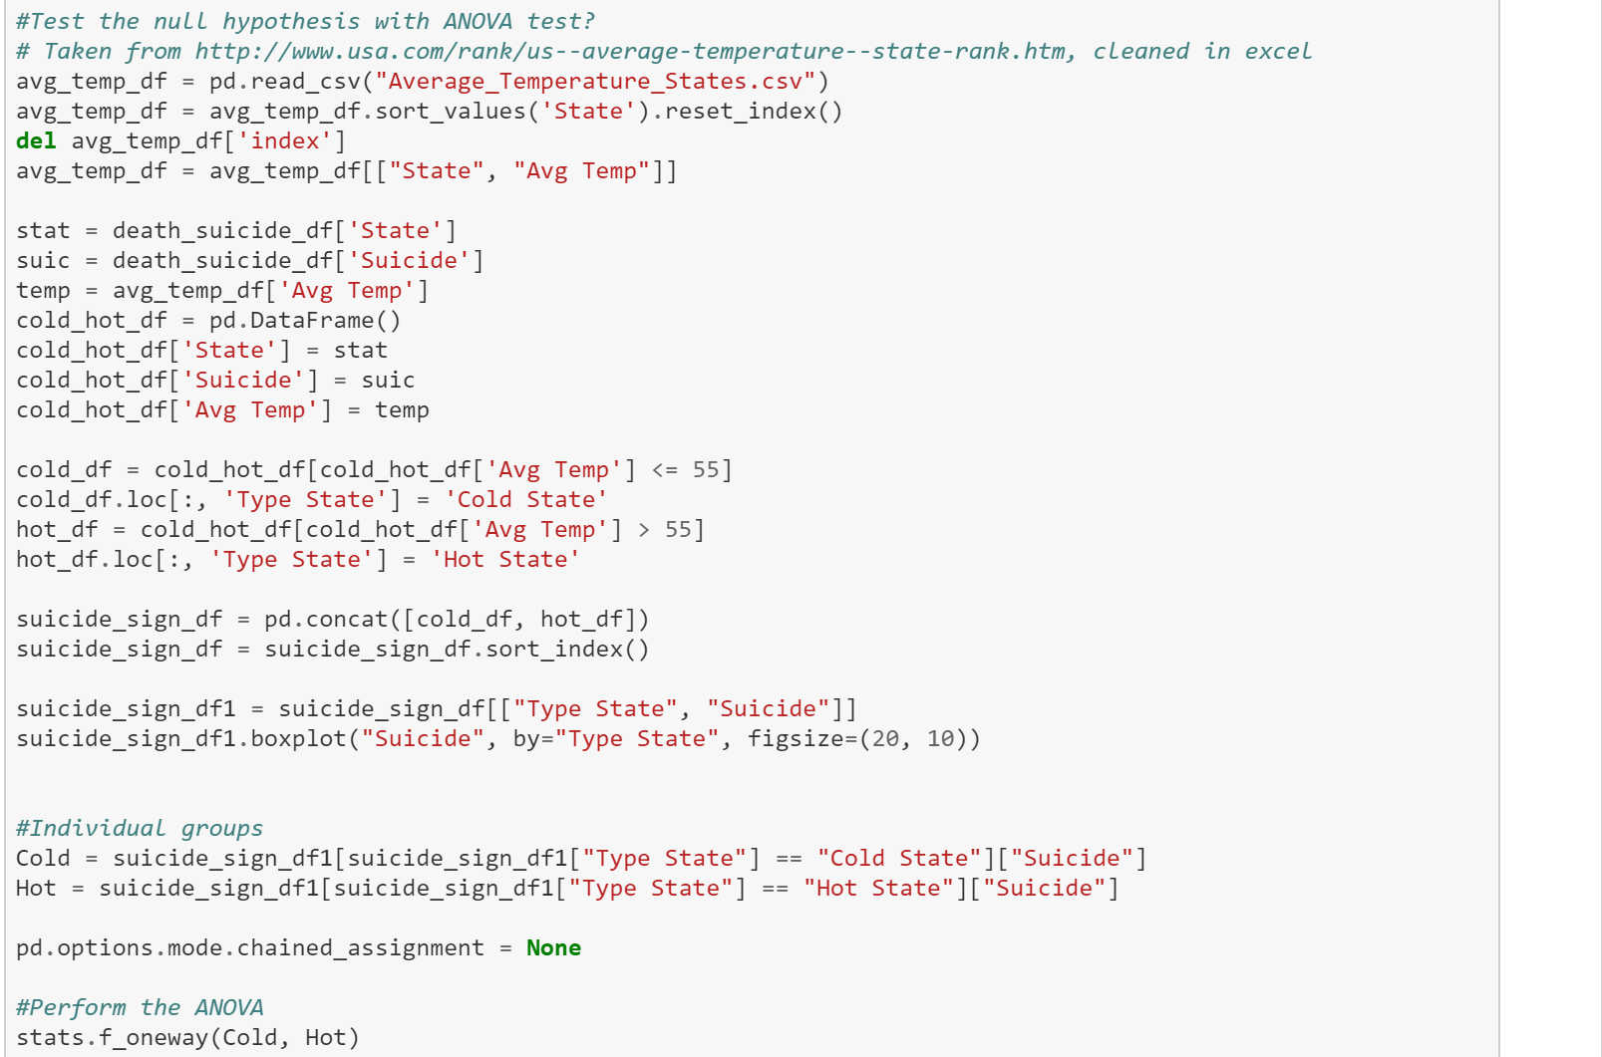
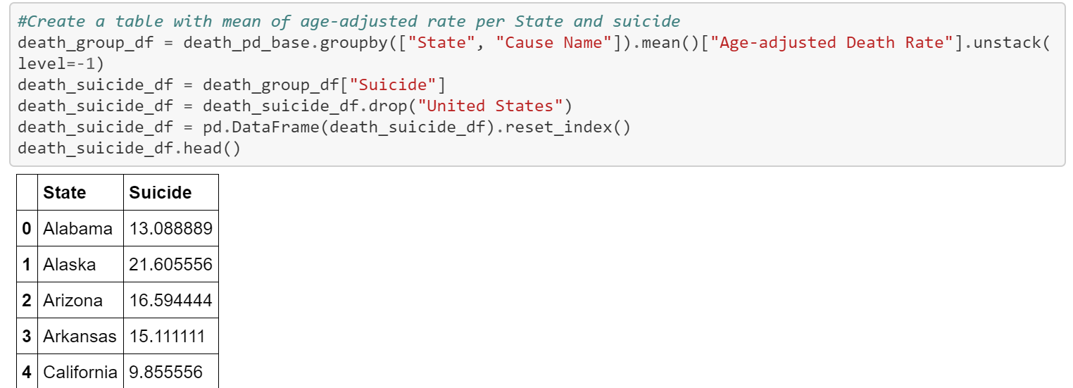
Null Hypothesis #2
- The death rate due to suicide is not significantly related to states with lower temperatures through the year.
Code and Analysis

Slide 31
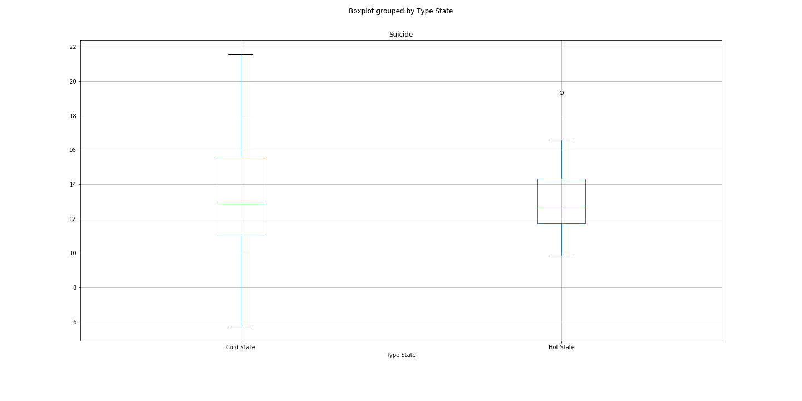
Suicide by State (Hot vs Cold)
F_onewayResult(statistic=0.021475903007916908, pvalue=0.8840911850460149)

Slide 32
Questions?

